Slide 1
The Relationship between Cryptocurrency and Energy Prices?
An Exploratory Analysis
Shermeen Ajani
Stuart Manito Smith
Timothy Smith
10-30-21

Slide 2

Crypto
Bitcoin
How is it made?
Enormous amount of power

Slide 3
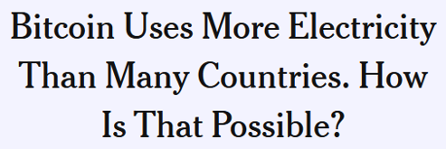
Energy Consumption
https://www.nytimes.com/interactive/2021/09/03/climate/bitcoin-carbon-footprint-electricity.html

Slide 4

Energy Consumption
https://www.theguardian.com/technology/2021/feb/27/bitcoin-mining-electricity-use-environmental-impact

Slide 5
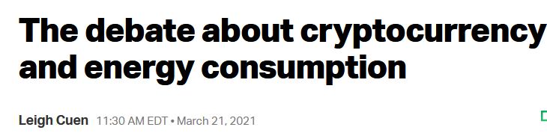
Energy Consumption
https://techcrunch.com/2021/03/21/the-debate-about-cryptocurrency-and-energy-consumption/

Slide 6

Energy Consumption
https://fortune.com/2021/05/13/musk-bitcoin-mining-bad-planet-heres-how-bad/

Slide 7

Energy Consumption
https://www.independent.co.uk/climate-change/news/bitcoin-mine-nft-oil-well-viral-b1816478.html

Slide 8

Energy Consumption

Slide 9
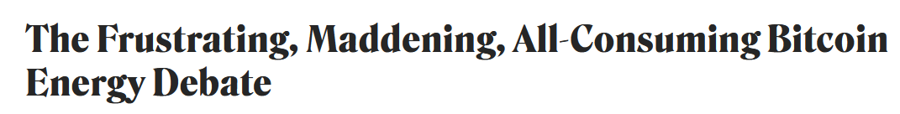
Energy Consumption
https://www.coindesk.com/business/2021/03/05/the-frustrating-maddening-all-consuming-bitcoin-energy-debate/

Slide 10
Data Sources
Cryptocurrency prices (Bitcoin, Dogecoin, Ether)
https://www.kaggle.com/sudalairajkumar/cryptocurrencypricehistory?select=coin_Bitcoin.csv
https://www.kaggle.com/sudalairajkumar/cryptocurrencypricehistory?select=coin_Dogecoin.csv
https://www.kaggle.com/sudalairajkumar/cryptocurrencypricehistory?select=coin_Ethereum.csv
Stock Market (S&P500, DJIA, etc)
https://www.kaggle.com/mattiuzc/stock-exchange-data?select=indexInfo.csv
Commodities prices (energy prices, oil)
https://www.kaggle.com/awadhi123/crude-oil-stock-price
https://github.com/owid/energy-data
https://fred.stlouisfed.org/series/PCU212111212111

Slide 11
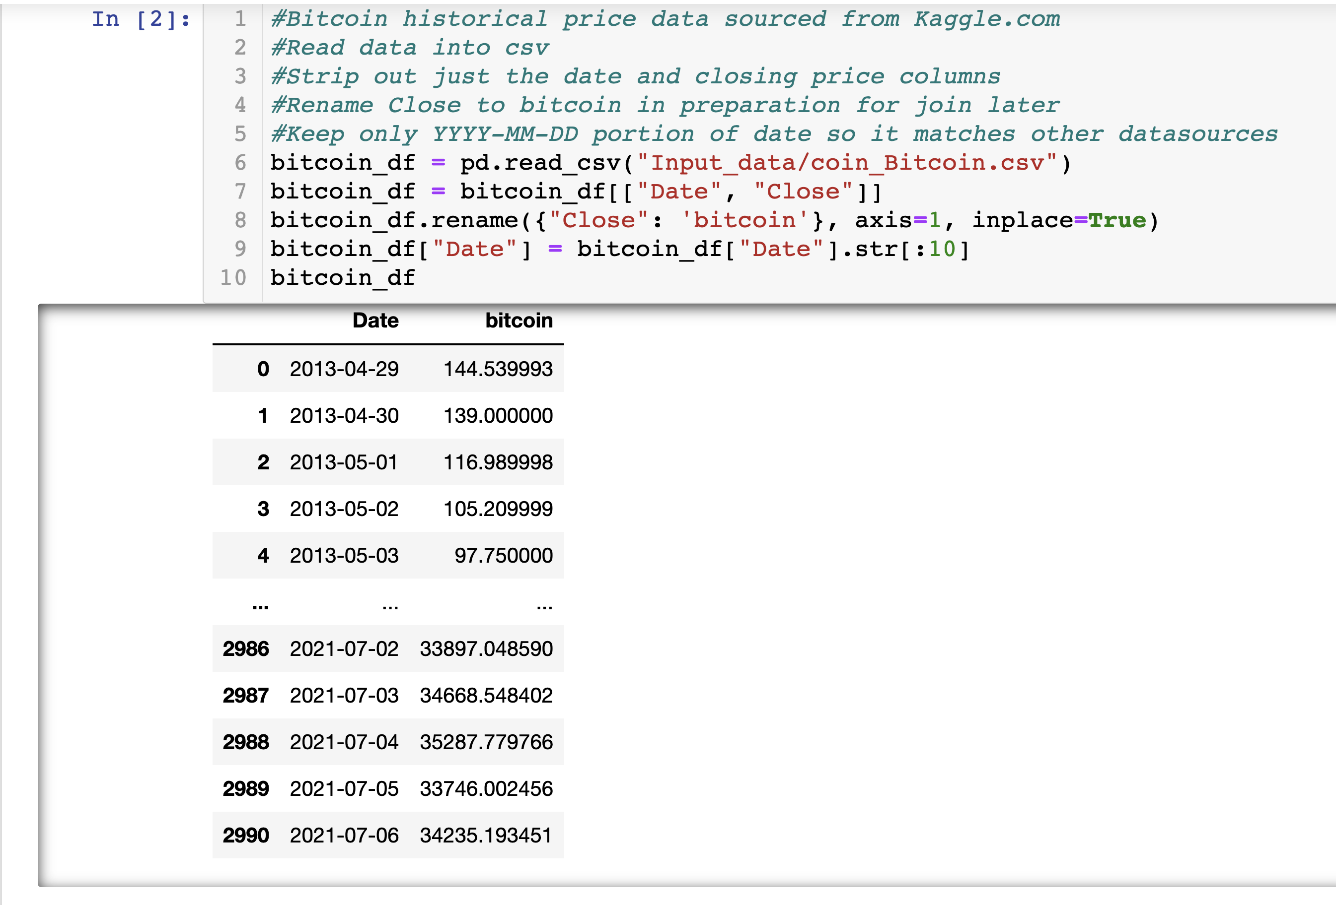
Reading and Cleaning Crypto Data

Slide 12
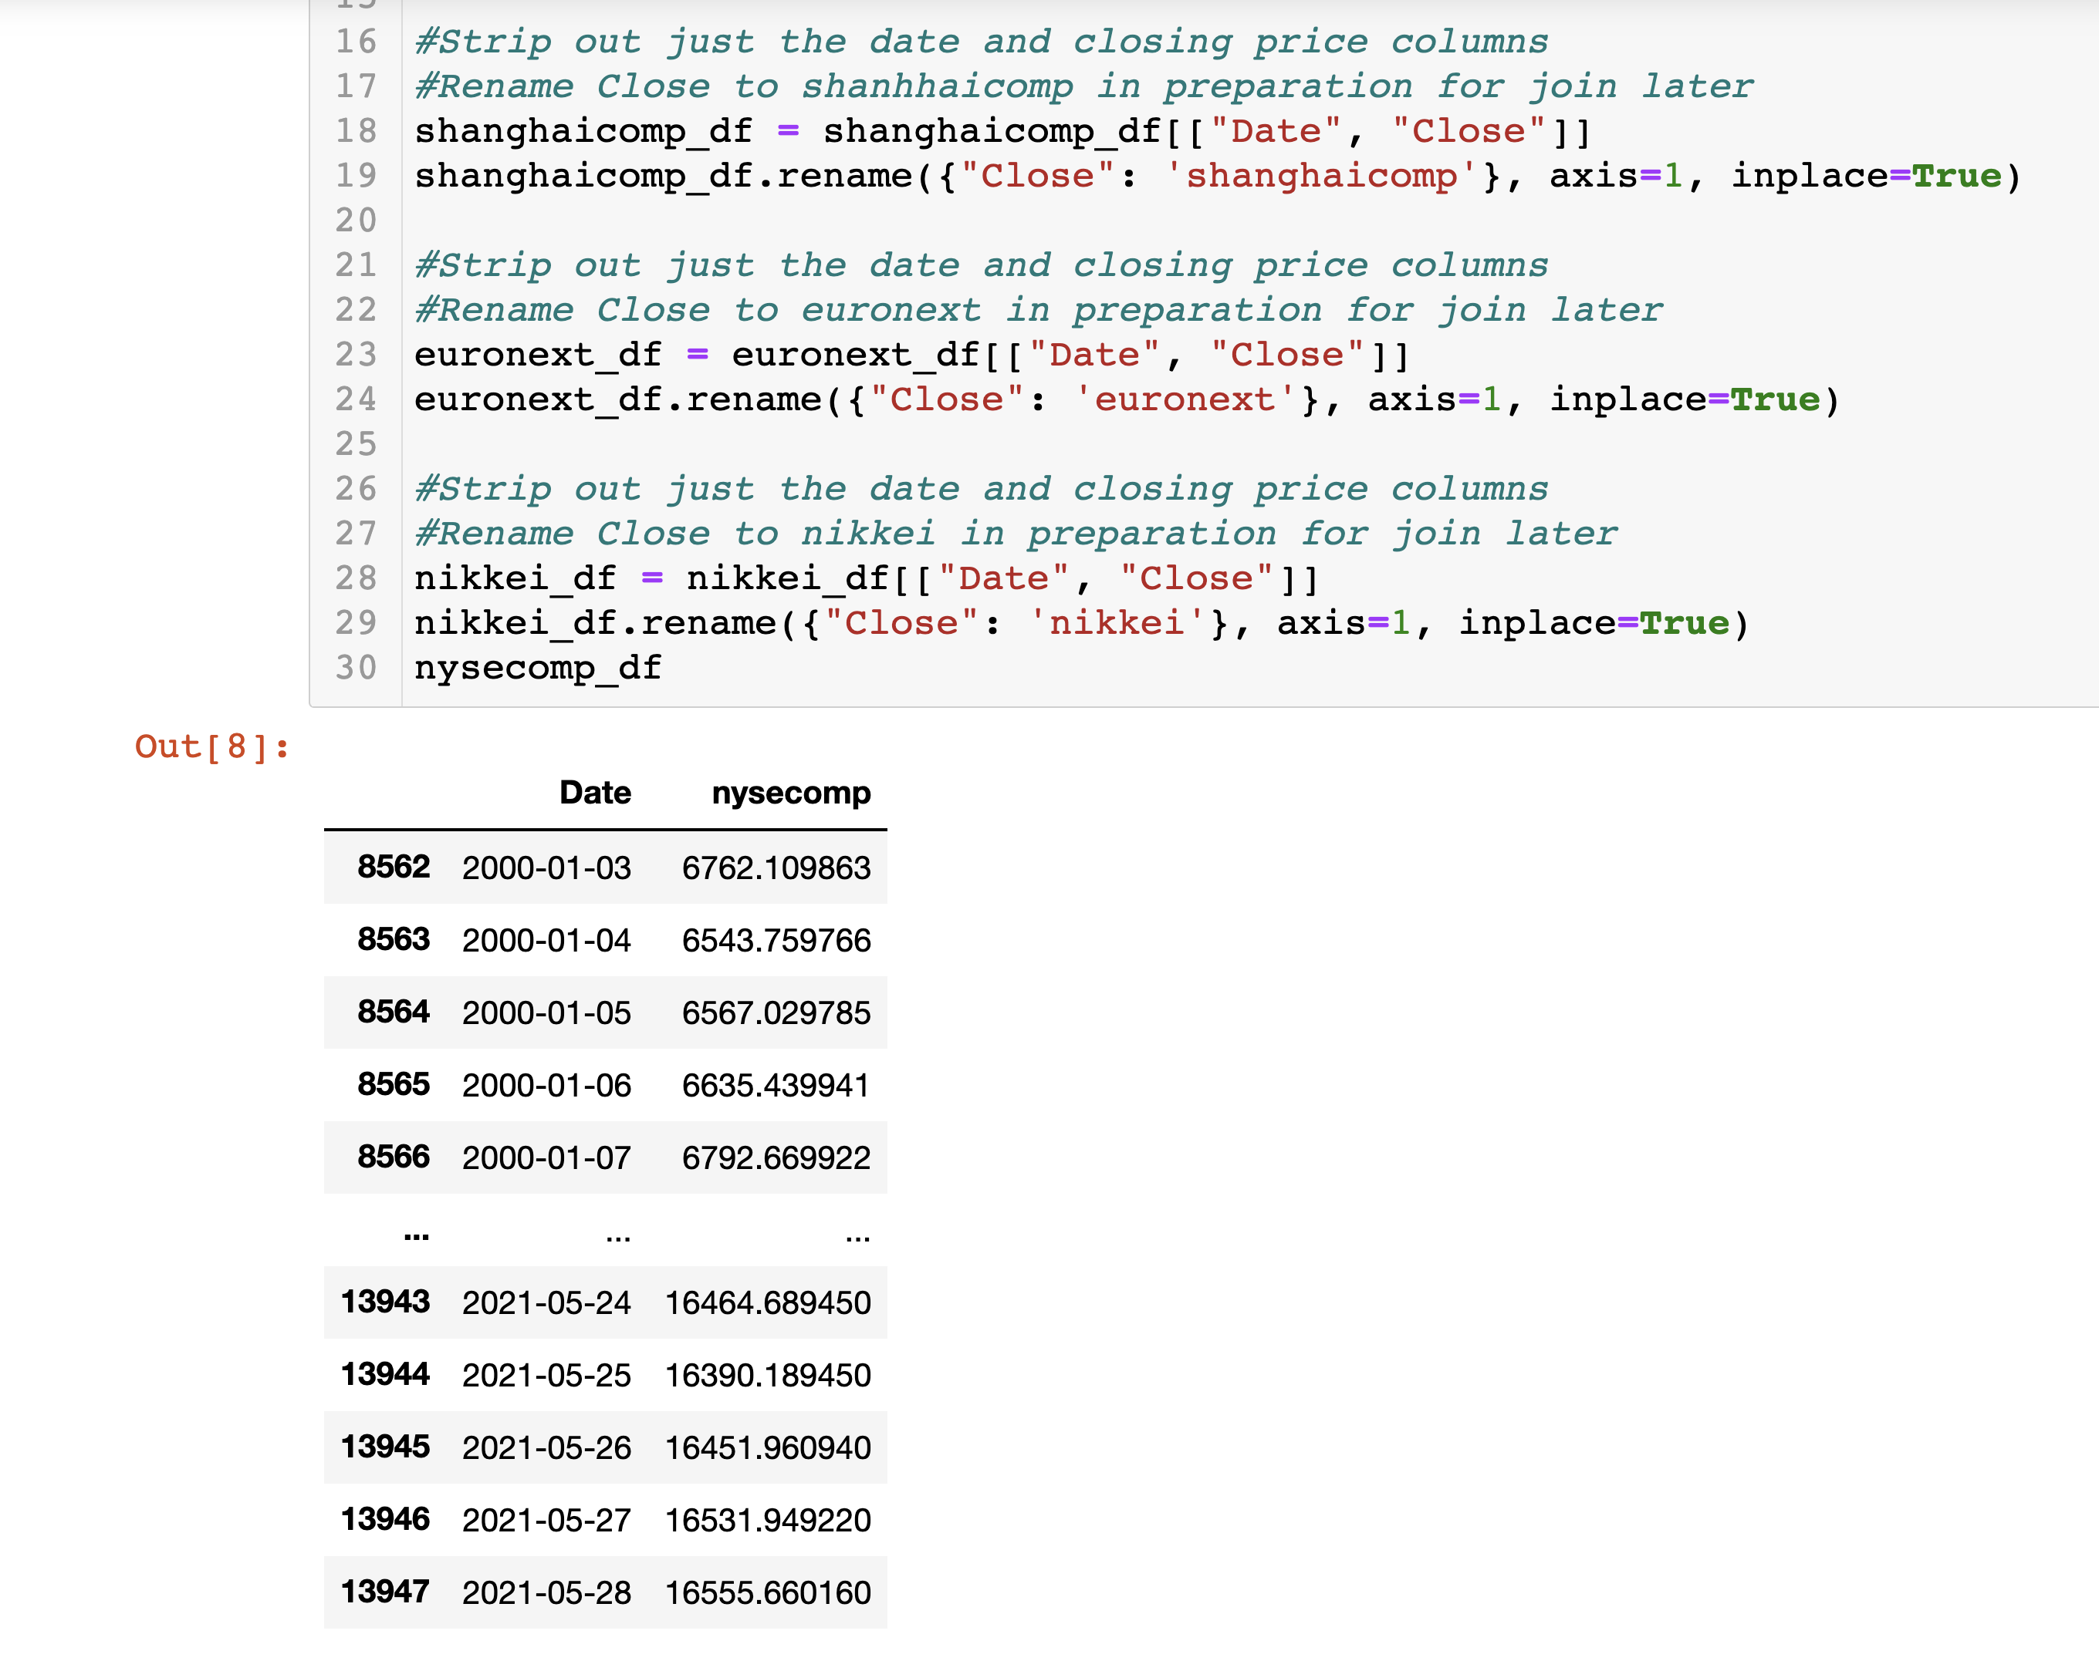
Reading and Cleaning Stock Data

Slide 13
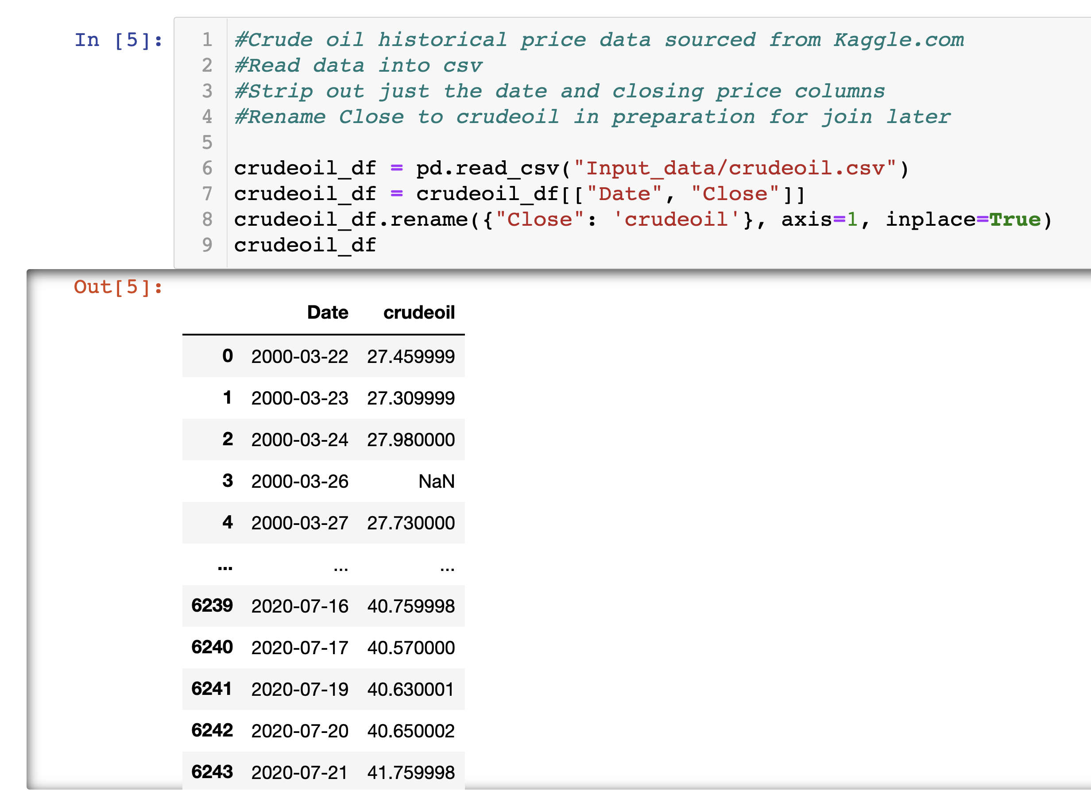
Reading and Cleaning Energy Data

Slide 14
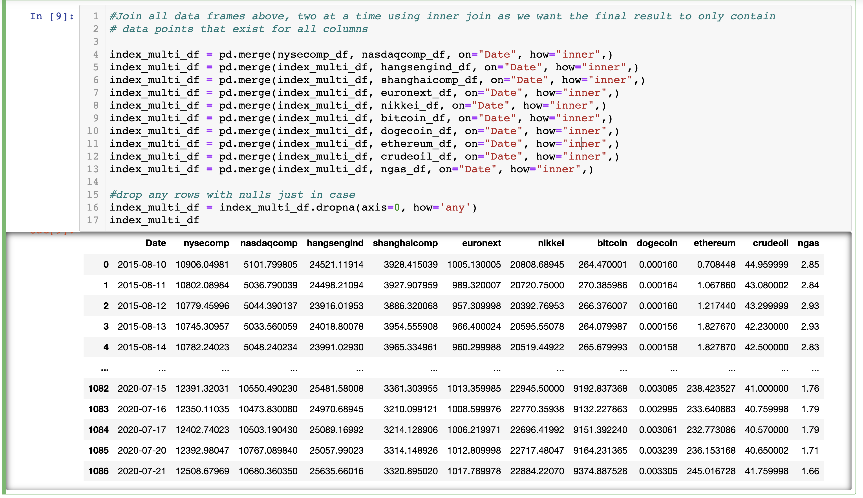
Combining Data

Slide 15
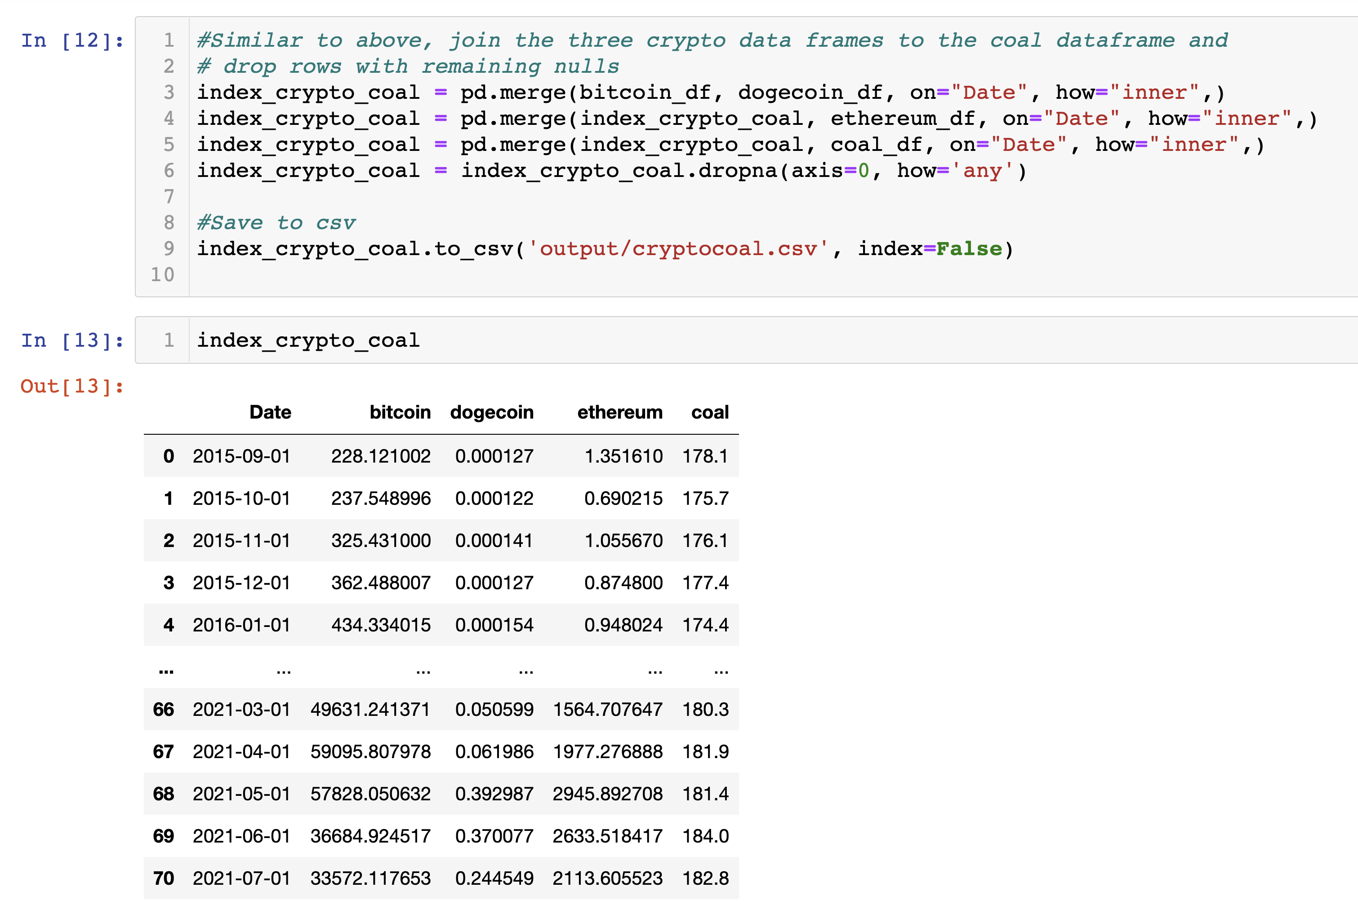
Combining Data

Slide 16
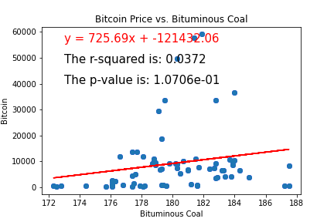
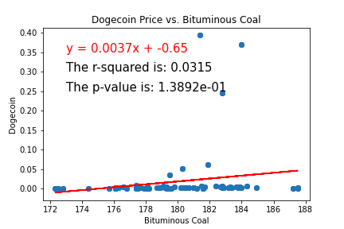
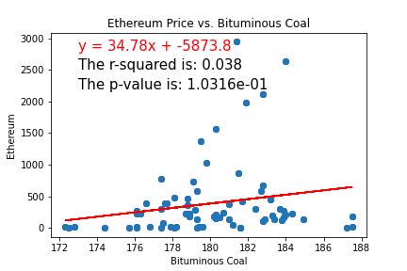
Analysis: Coal

Slide 17
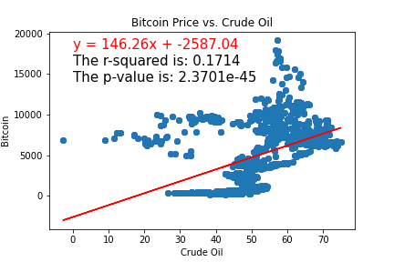
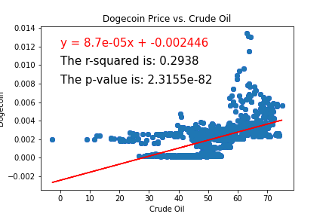
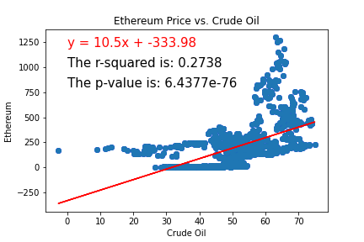
Analysis: Crude Oil

Slide 18
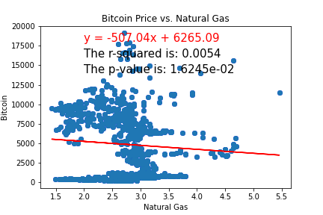
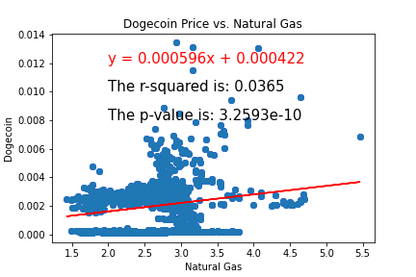
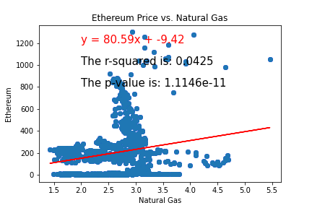
Analysis: Natural Gas

Slide 19
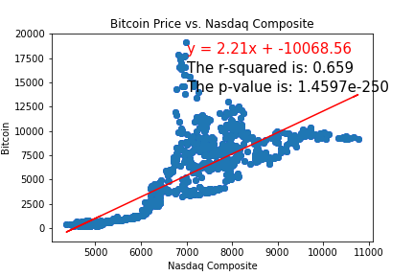
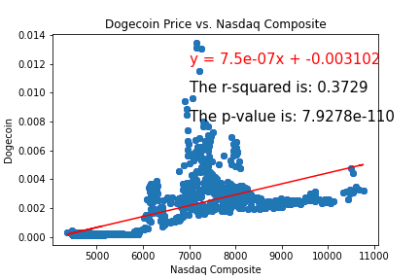
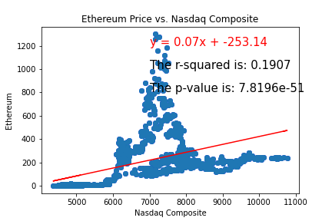
Analysis: NASDAQ

Slide 20
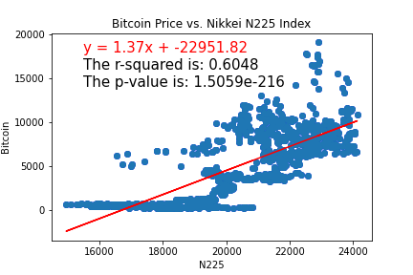
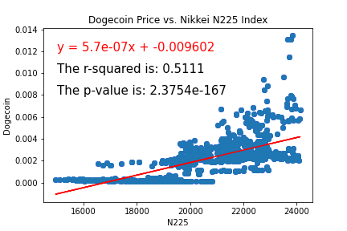
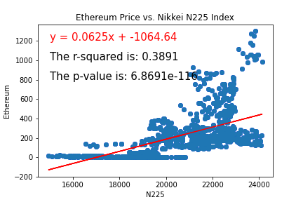
Analysis: Nikkei N225

Slide 21
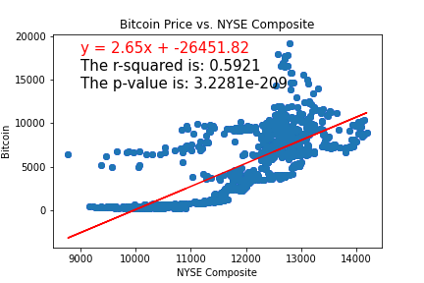
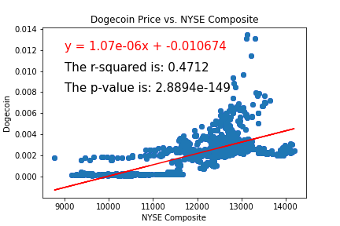
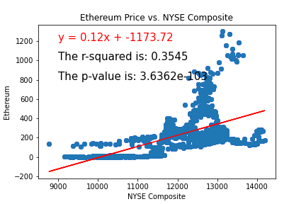
Analysis: NYSE

Slide 22
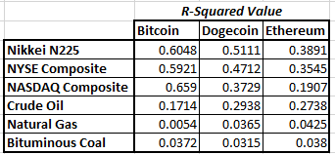
R-Squared Values

Slide 23
Conclusion
Is there any relationship between cryptocurrency prices and energy prices?
Our findings DO NOT
indicate there is

